Slide 1
Analyzing Health Seeking Behavior in Response to Respiratory Diseases
in Illinois
Alyssa Anastasi
Research Advisors: Sophie Larsen & Pamela Martinez

Slide 2
Background – Vaccinations
COVID-19 Vaccines:
Story:
Benefits of Vaccination (obvious, but worth showing data)
Adult Determinants
How that impacts child determinants

Slide 3
Background – Adult vs Child Vaccination Behavior

Slide 4
Background – SHIELD Survey Illinois

Slide 5
How do adults and children behave differently with respect to vaccination behavior?
Are these consistent across respiratory pathogens?

Slide 6
Survey Exploration

Slide 7
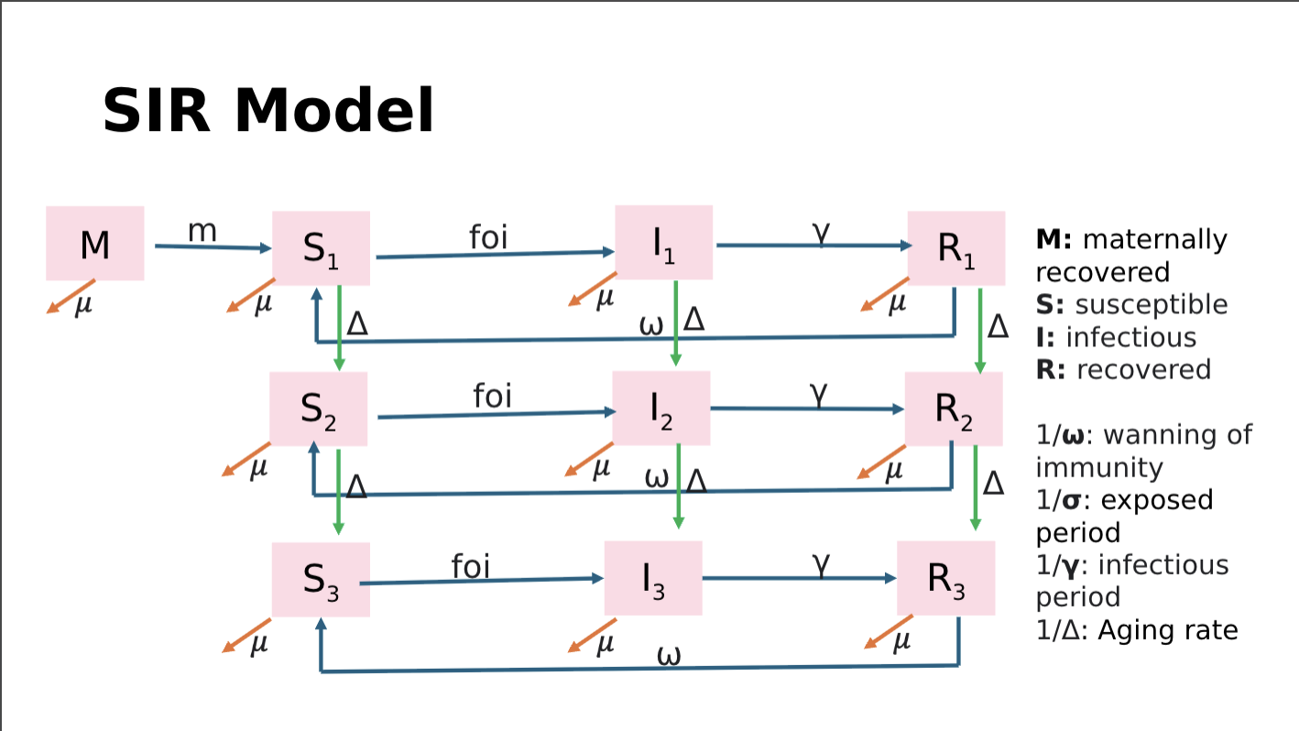
SEIRD Model – COVID-19
*Figure like this (but for our model)

Slide 8
SEIR Model – Initial Results

Slide 9
The change in management process
There are 5 key steps in an organizational change:
01
02
03
04
05
Identify the need for change
Develop a vision and strategy
Engage stakeholders
Implement the change
Evaluate and sustain the change

Slide 10
What’s inside
01
Introduction
02
Types of change
03
The change management process
04
Key questions for driving successful change

Slide 11

Introduction
Organizational change refers to any shift or transformation in how the company operates.
It may include changes in:
Internal processes
Company culture
Infrastructure
Many others

Slide 12


Types of Change
Organizational change can
either be adaptive or transformational.
Adaptive
Transformational
Involves small, gradual,
incremental changes
Represents significant and sudden shifts from the existing practices

Slide 13
01
Identify the need for change
Use the table to outline the reasons why the change is necessary.
Factors to consider | Notes
Background What current problems need to be solved? How did we get here?
Current state Where are we now? What opportunities are being missed?
Risks of not taking action What future issues might arise if no action is taken?
Benefits of taking action What are the benefits of making the change?

Slide 14


02
Develop a vision and strategy
Use the guide questions below when crafting a strategic plan.
Strategic goals
Key performance indicators
Project stakeholders
and team
Project scope
How does this change align with the organization’s objectives?
What indicators will track progress?
Which metric needs improvement?
What is the current status?
Who will lead the change initiative?
Who needs to approve the key decisions?
What specific actions and steps are included in this project?

Slide 15
03
Engage stakeholders
Consider how to approach and engage each stakeholder throughout the project.
C-level executives
Project sponsors
Subject matter experts
Process owners
Individual end-users
Frontline employees
Business unit leaders

Slide 16
04
Implement the change
Use the sample action plan template to show the steps and timeline for each phase
Action | Assigned | Priority | Status | Start Date | End Date | Notes
Phase 1: Pilot Testing |  |  |  | YYYY/MM/DD | YYYY/MM/DD | Add notes here
Add step 1 here. | Name | High, Medium, Low | Complete, In progress, Not started | YYYY/MM/DD | YYYY/MM/DD | Add notes here.
Phase 2: Add details here

Slide 17

05
Evaluate and sustain the change
Use the graphic as a guide in identifying and tracking success metrics for the change initiative.
Communicate and share findings
05
01
Design success metrics strategy
Continuous Improvement Feedback Loop
Adjust success metrics (if necessary)
04
02
Collect data
03
Analyze data

Slide 18

Key questions
for driving successful change
01
Why is the change necessary?
Identify the key drivers and reasons behind the change.
02
What’s your action plan?
Develop a detailed strategy to setup the team for success.
03
How will you communicate the change?
Some questions managers and business leaders should consider during a transition include:
Create a communication plan to engage the team and stakeholders.
04
What challenges might you encounter?
Identify potential roadblocks and prepare strategies to mitigate them.

Slide 19


Thank you!
Your name or organization
Email
hello@reallygreatsite.com
Social media
@reallygreatsite
Phone
123-456-7890
Address
123 Anywhere St., Any City, ST 12345
Your name or organization

Slide 20






































Resource Page
Use these in your presentation. Delete or hide this page before presenting.
Fonts
Design Elements
This presentation template
uses the following free fonts:
TITLES & HEADERS:
IBM PLEX SERIF
SUBHEADERS:
IBM PLEX MONO
BODY COPY:
IBM PLEX SANS
You can find these fonts online too.
Colors
#353824
#D7DAC9
#F5F3EB

Slide 21


Credits
This presentation template is free for everyone to use, thanks to the following:
Pexels, Pixabay
for the presentation template
for the photos
Happy designing!

